Slide 1
DG INTERNS HUB / INTERNSHIP PRESENTATION
Cybersecurity Internship
Week 1 — Practical Progress
Virtual labs • Linux foundations • Networking • TryHackMe • Bandit
Evidence-based summary | October 2026
Prepared by: Swarnachandran Kesheth
01

Slide 2
DG INTERNS HUB / WEEK 01
Week 1 objectives
BUILD
CONNECT
Set up isolated virtual machines for hands-on practice.
Configure IP addresses and verify VM communication.
PRACTISE
LEARN
Use Linux administration and networking commands.
Complete guided security learning challenges.
02

Slide 3
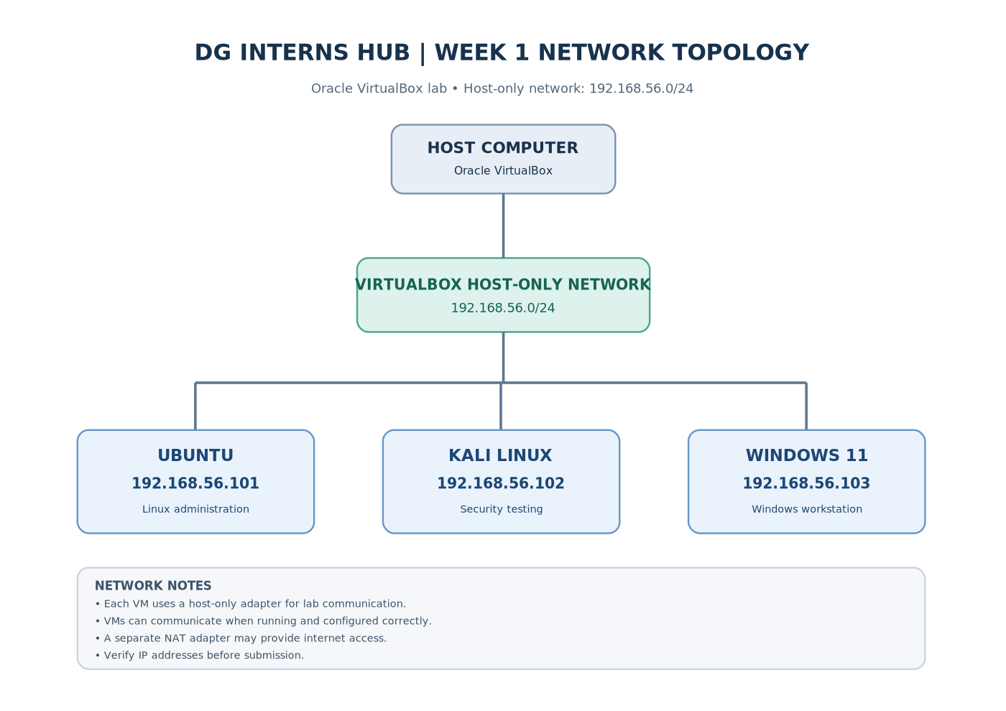
DG INTERNS HUB / WEEK 01
Virtual lab environment
Ubuntu Linux
192.168.56.101
Kali Linux
192.168.56.102
Windows 11
192.168.56.103
Host-only network: 192.168.56.0/24 | NAT used for internet access
03

Slide 4
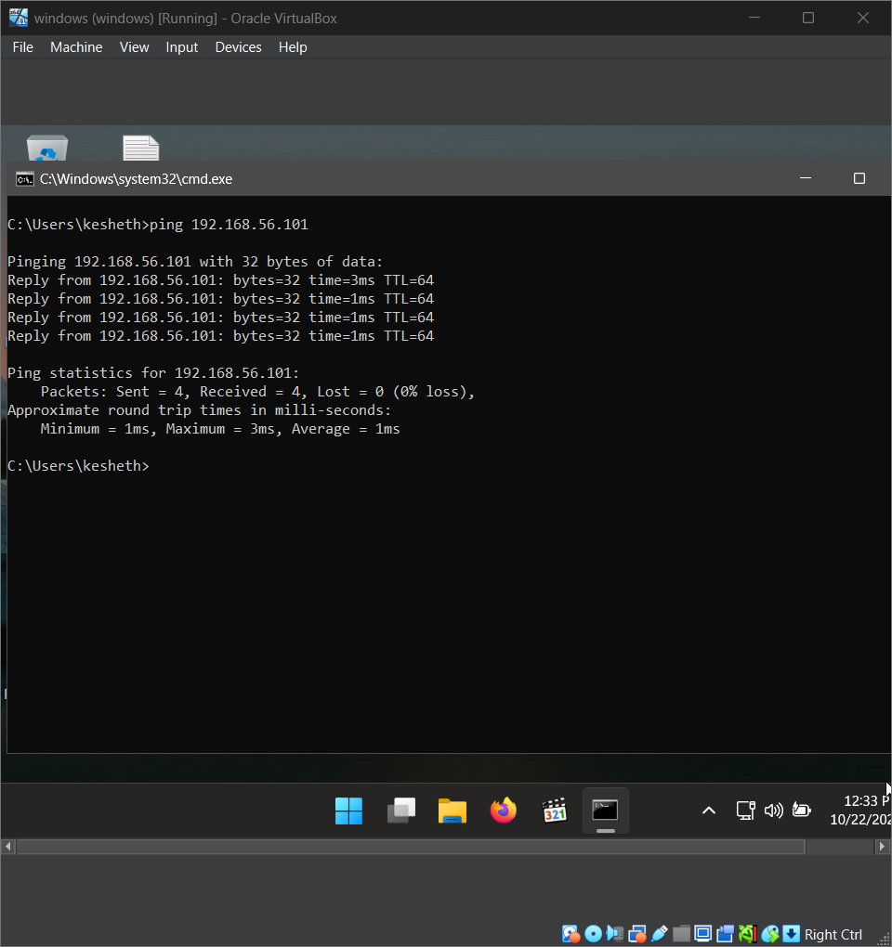
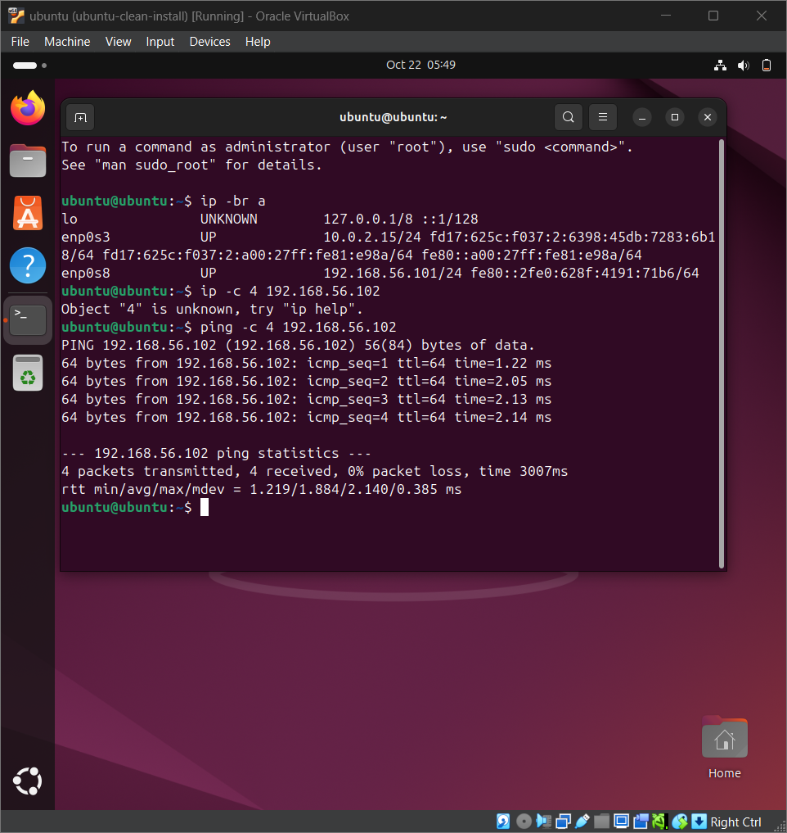
DG INTERNS HUB / WEEK 01
Networking verification
Observed ping tests showed successful VM-to-VM communication with 0% packet loss in recorded checks.
04

Slide 5
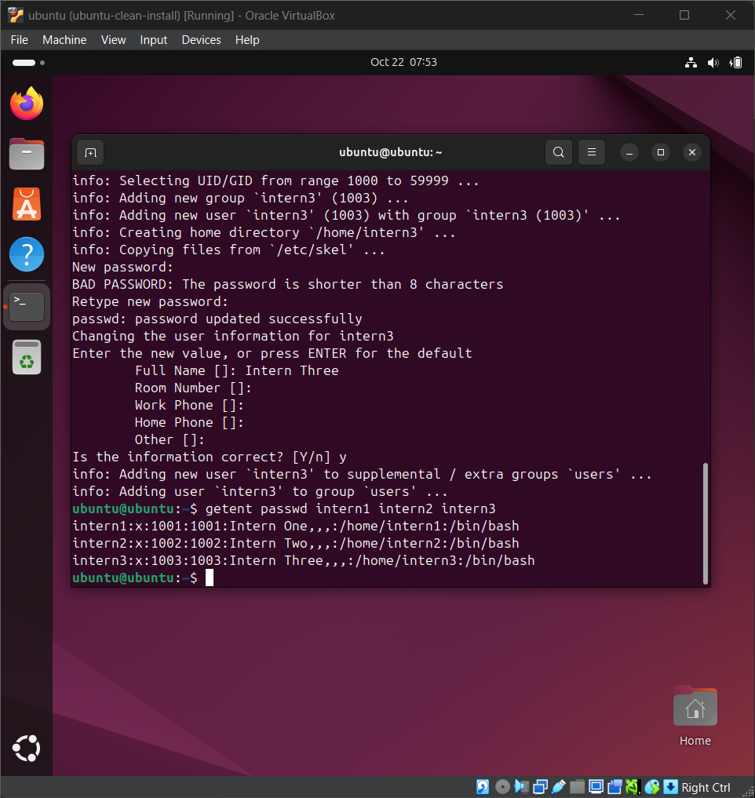
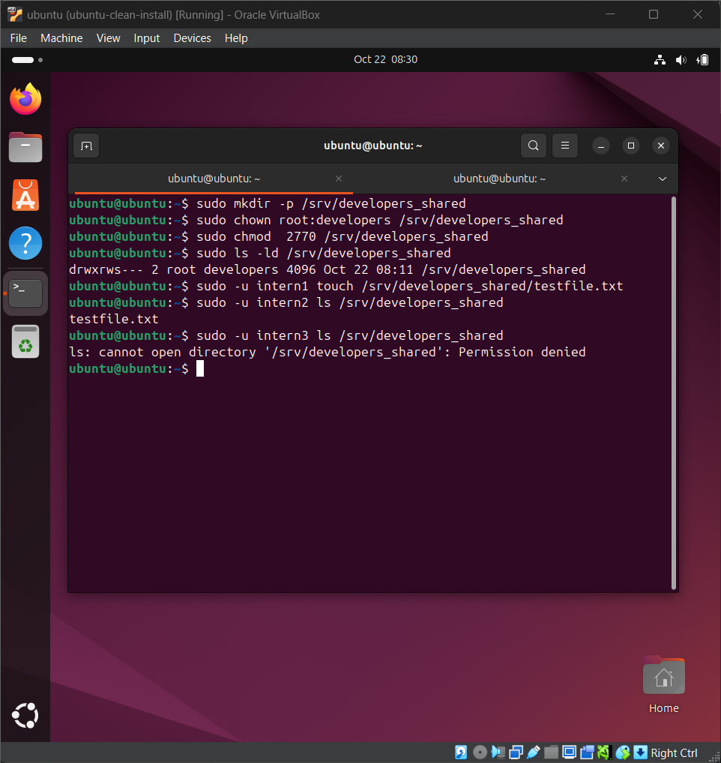
DG INTERNS HUB / WEEK 01
Linux users, groups and permissions
Practised account management, groups, shared directories and permission commands. Final permission configuration should be verified before submission.
05

Slide 6
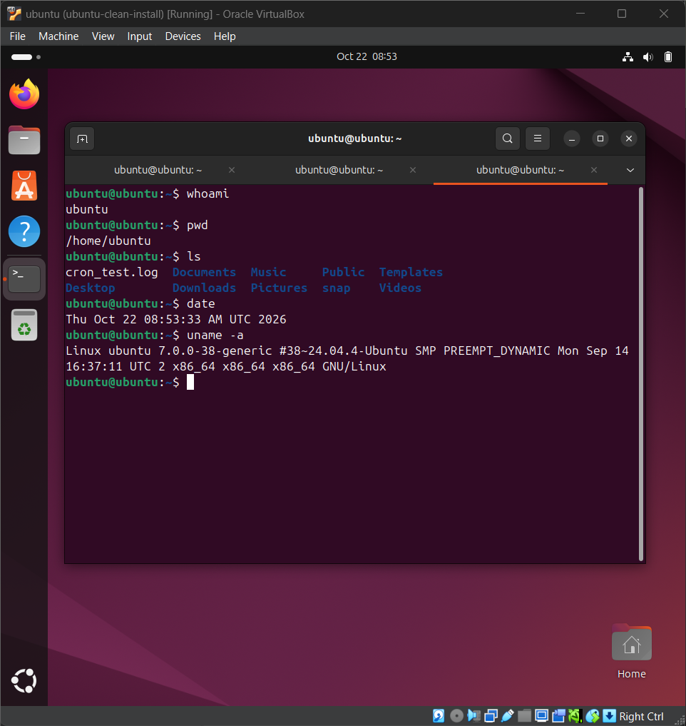
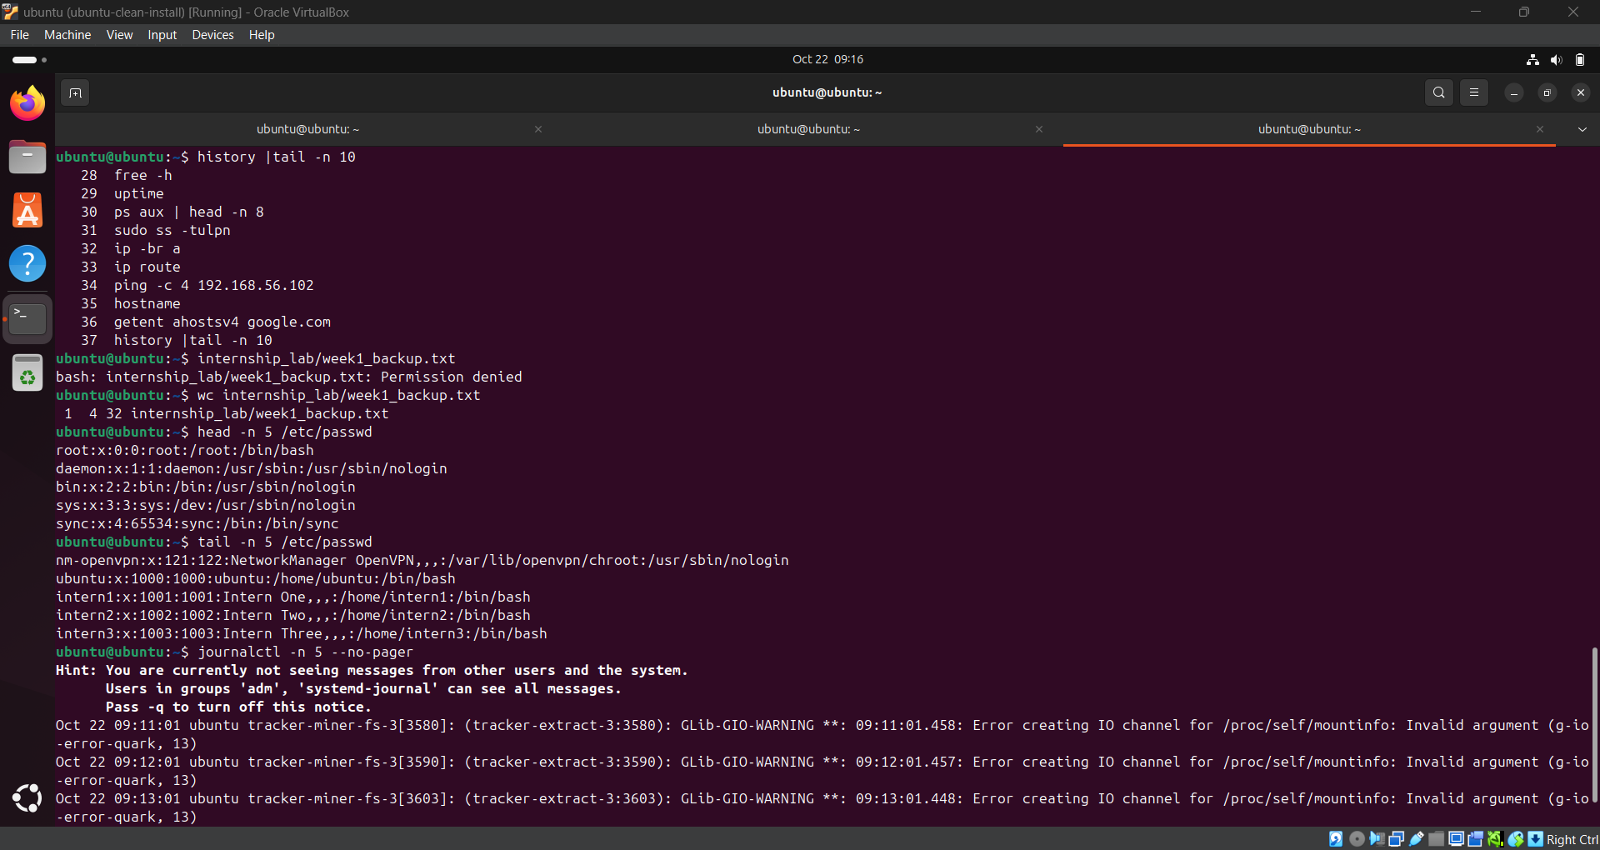
DG INTERNS HUB / WEEK 01
Linux command-line practice
30-command cheat sheet prepared: command • what it does • when to use it.
06

Slide 7
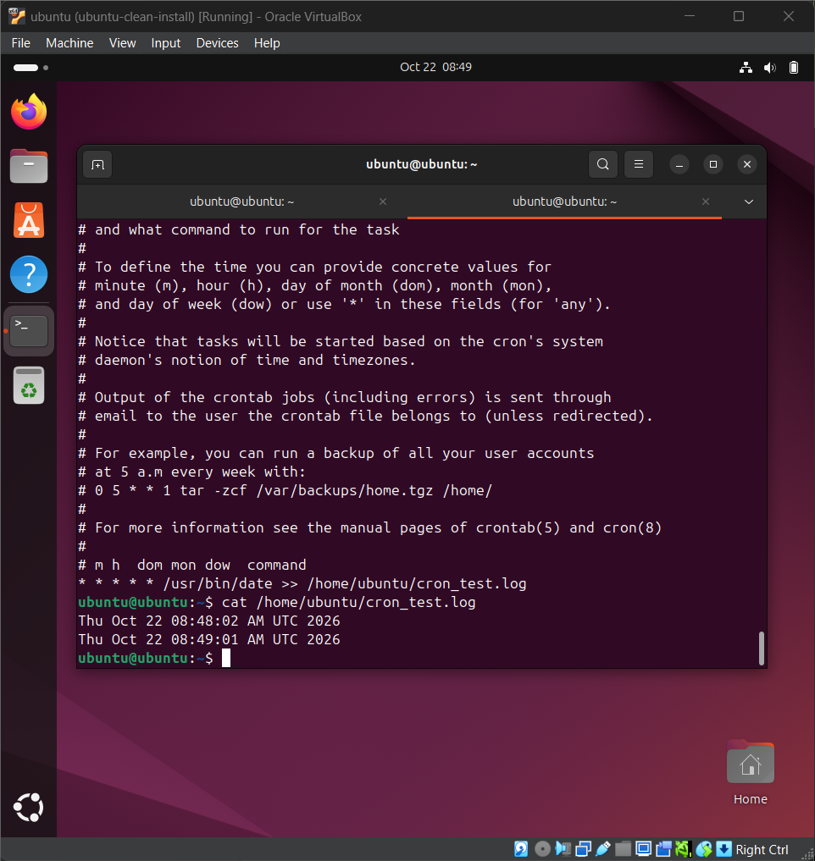
DG INTERNS HUB / WEEK 01
Automation and system administration
Cron job practice
Process and port inspection
Filesystem and permissions review
07

Slide 8
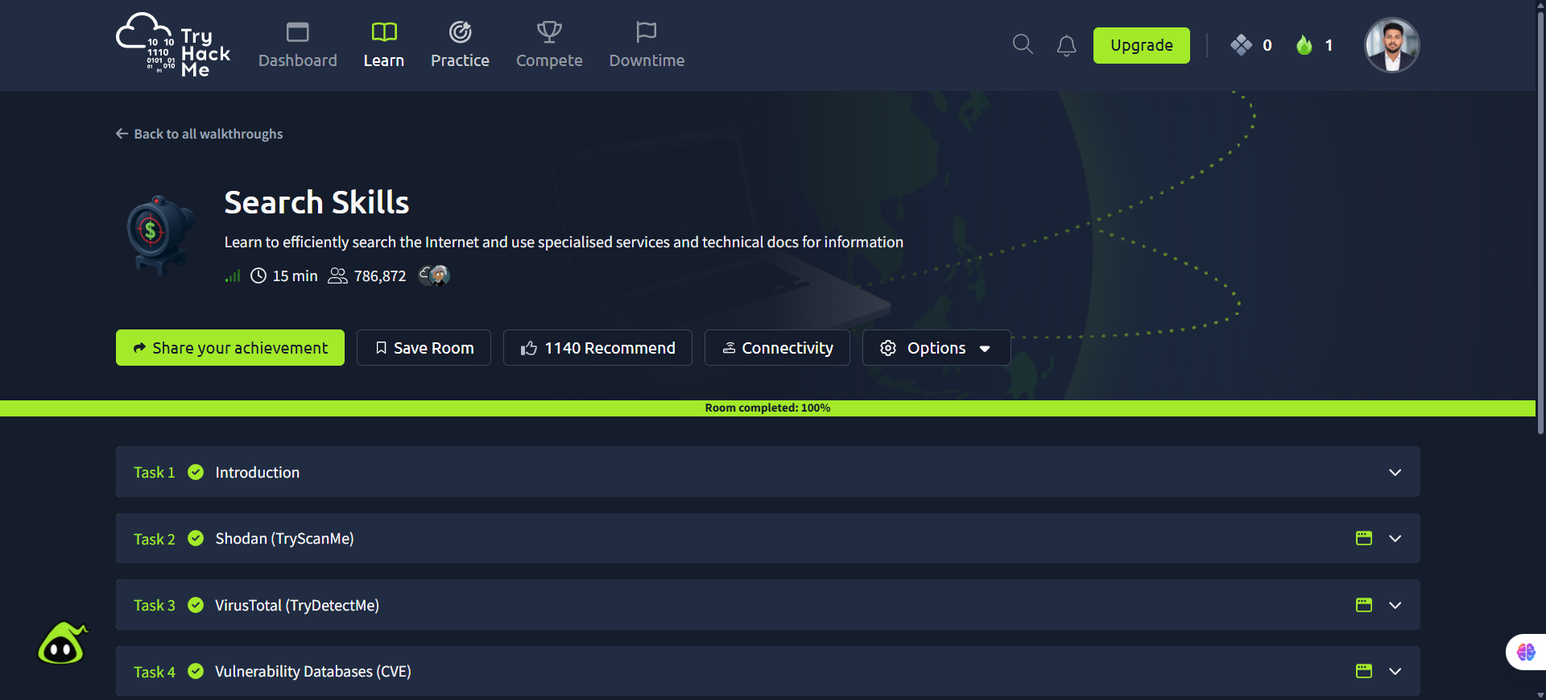
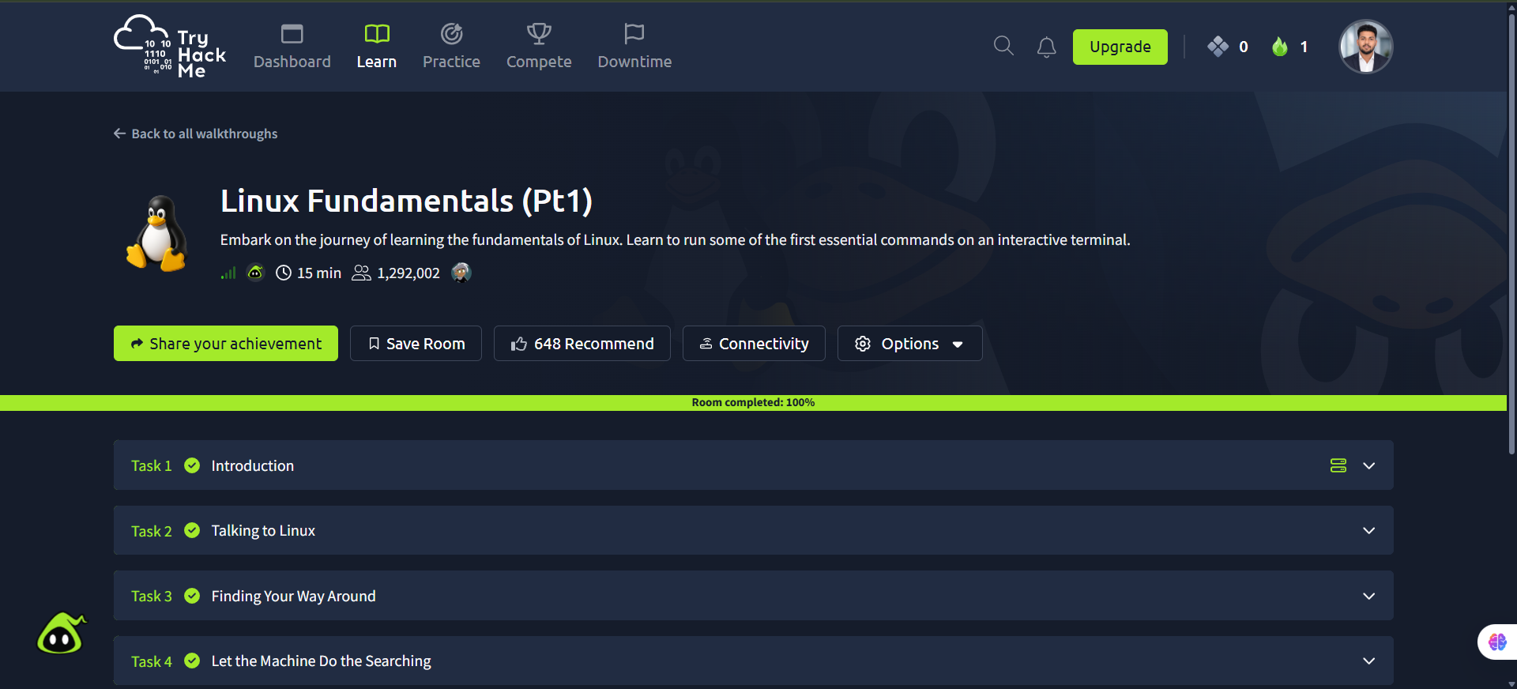
DG INTERNS HUB / WEEK 01
TryHackMe learning activities
Documented rooms include Search Skills, Learning Cyber Security, Linux Fundamentals, Introductory Networking, Networking Concepts, Intro to LAN and Pyramid of Pain.
08

Slide 9
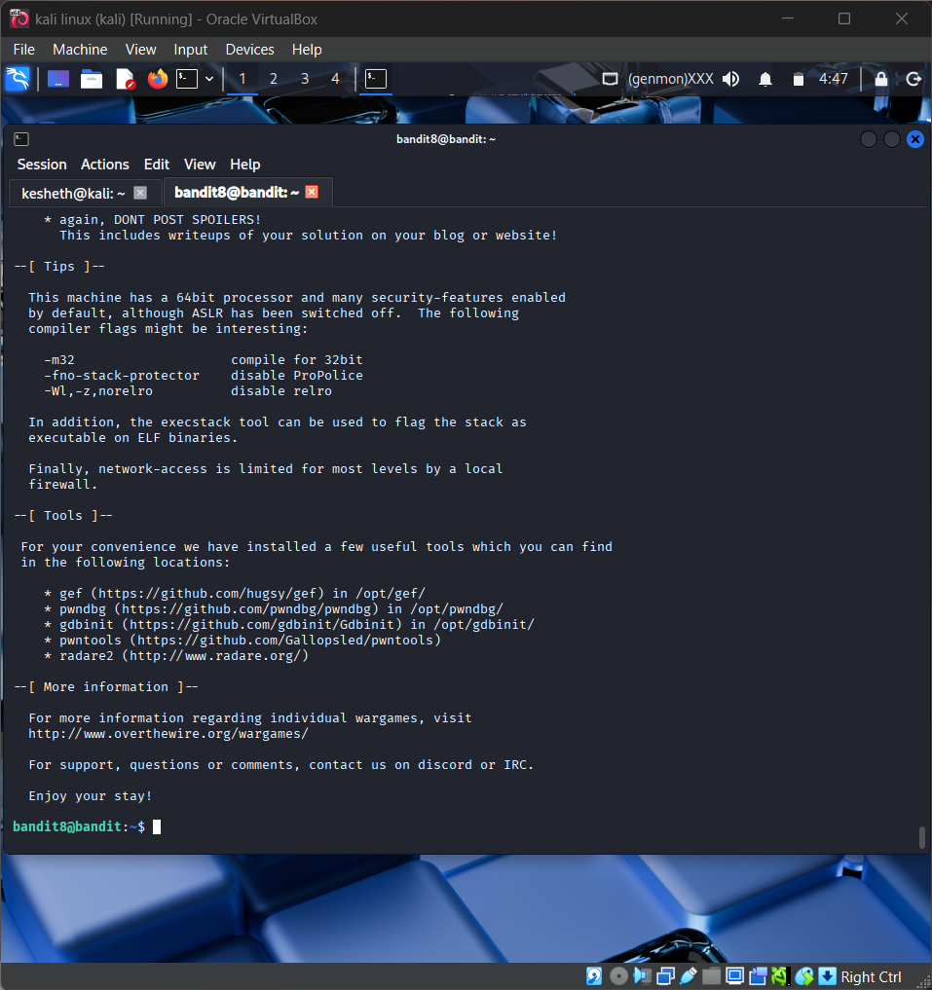

DG INTERNS HUB / WEEK 01
OverTheWire Bandit practice
SSH-based Linux challenges: navigating files, inspecting content and applying shell utilities. Level writeups saved separately.
09

Slide 10
DG INTERNS HUB / WEEK 01
Week 1 submission deliverables
NOTES
WRITEUPS
FINDINGS
8 separate theory documents
TryHackMe + Bandit level files
Screenshots and network diagram
CHEAT SHEET
REPORT
PRESENTATION
Exactly 30 Linux commands
Editable Word + weekly PDF
This PowerPoint + README pending
10

Slide 11
DG INTERNS HUB / WEEK 01
Key learning & next steps
• Built a multi-VM cybersecurity practice environment.
• Verified connectivity between the lab machines.
• Strengthened Linux and basic networking skills.
• Documented TryHackMe and Bandit learning evidence.
• Next: review evidence, finalize README and check submission requirements.
Thank you
11

